Slide 1

FUTURE CONFERENCES

Slide 2
Edinburgh, Scotland
ISPP’s 2017 Annual Conference Location

Slide 3
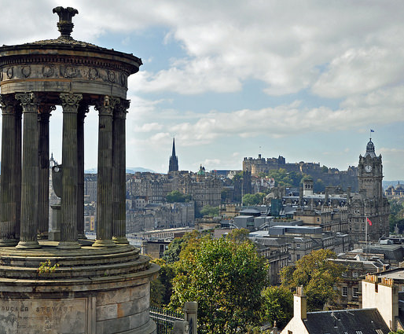
Edinburgh
The capital of Scotland makes an unforgettable impression with its historic, hilly landscape atop a series of extinct volcanos. A sense of history is all around you here - Edinburgh won’t disappoint if you’re looking for a flavor of old Scotland. –Photos credited to “This is Edinburgh” www.marketingedinburgh.org/conventions

Slide 4
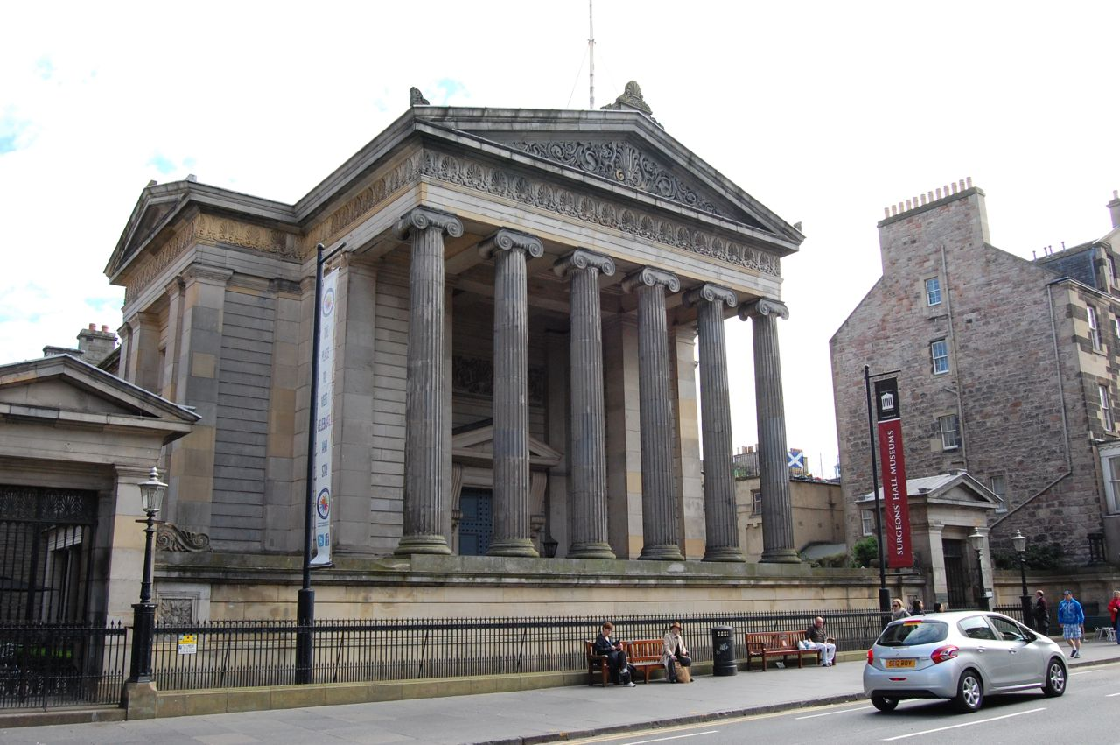
The Royal College of Surgeons
The Royal College of Surgeons of Edinburgh is the oldest and largest of the UK surgical Royal Colleges, and one of the largest of all the UK medical Royal Colleges. It will be serving as the location of ISPP’s 2017 Annual Conference.

Slide 5
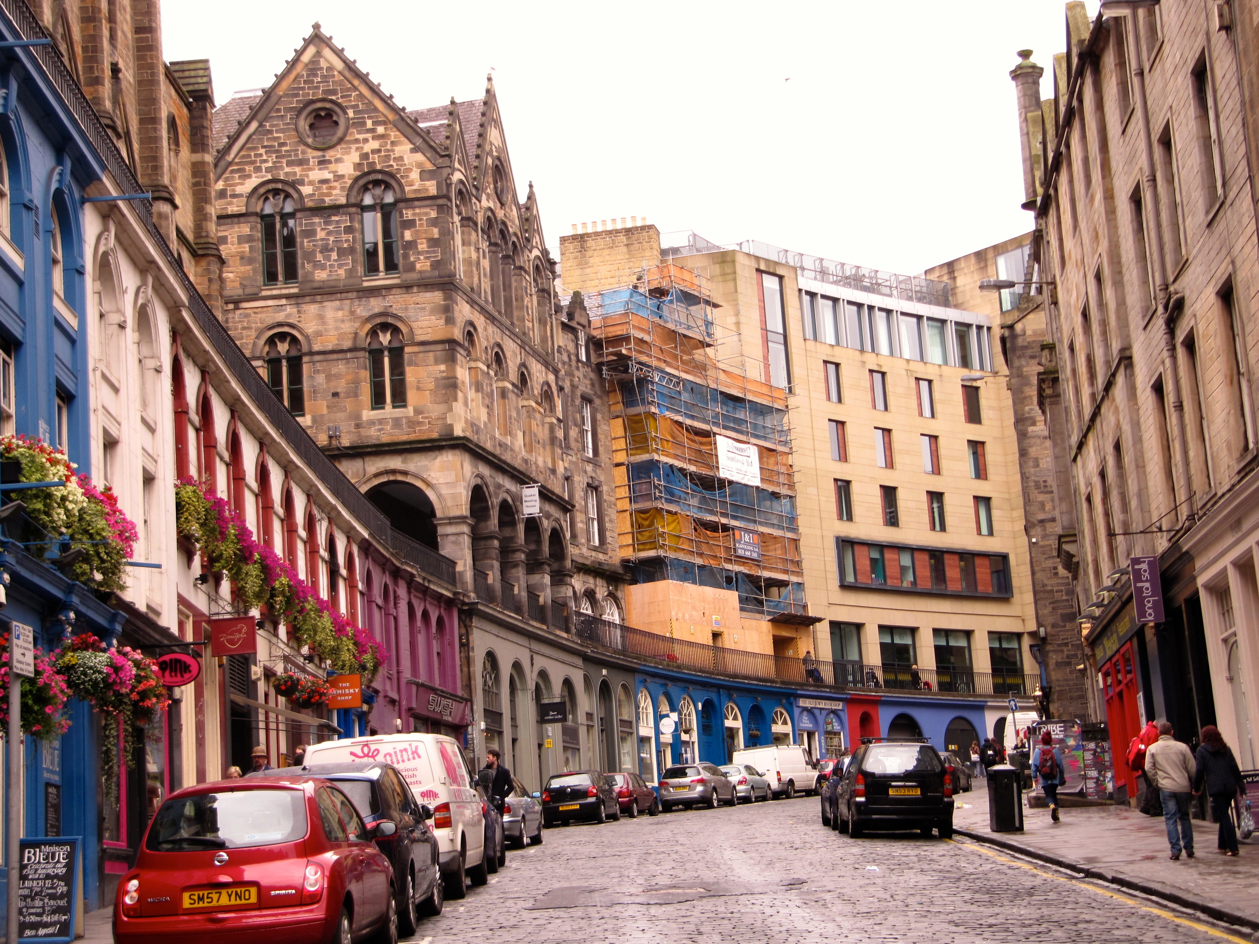
The Royal Mile
Leading from Edinburgh Castle to the Palace of Holyroodhouse, Edinburgh's Royal Mile is the heart of Scotland's historic capital. It connects the magnificent Edinburgh Castle, perched high on a base of volcanic rock, with the splendorous Palace of Holyroodhouse, resting in the shadow of Arthur's Seat.

Slide 6


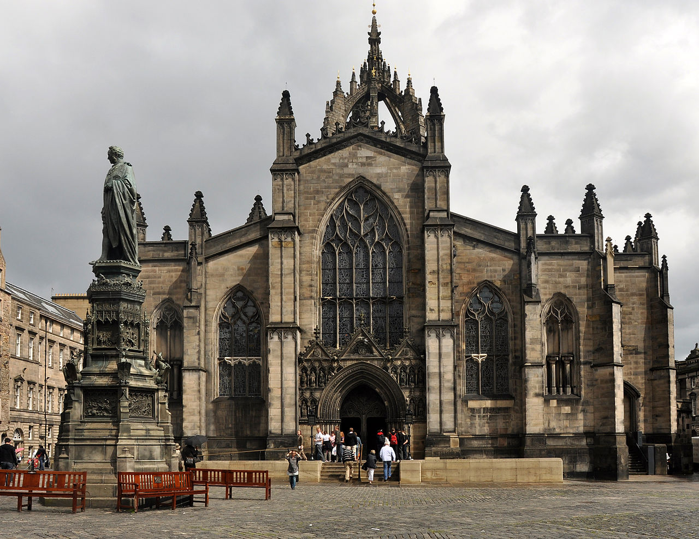
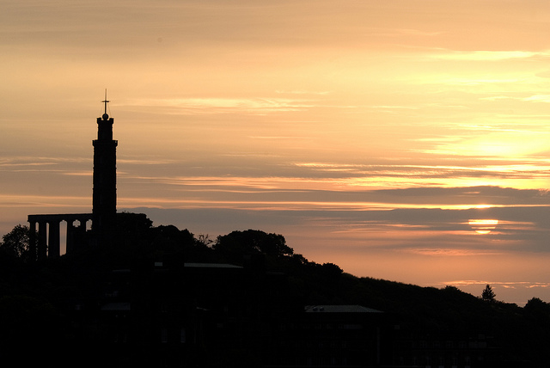
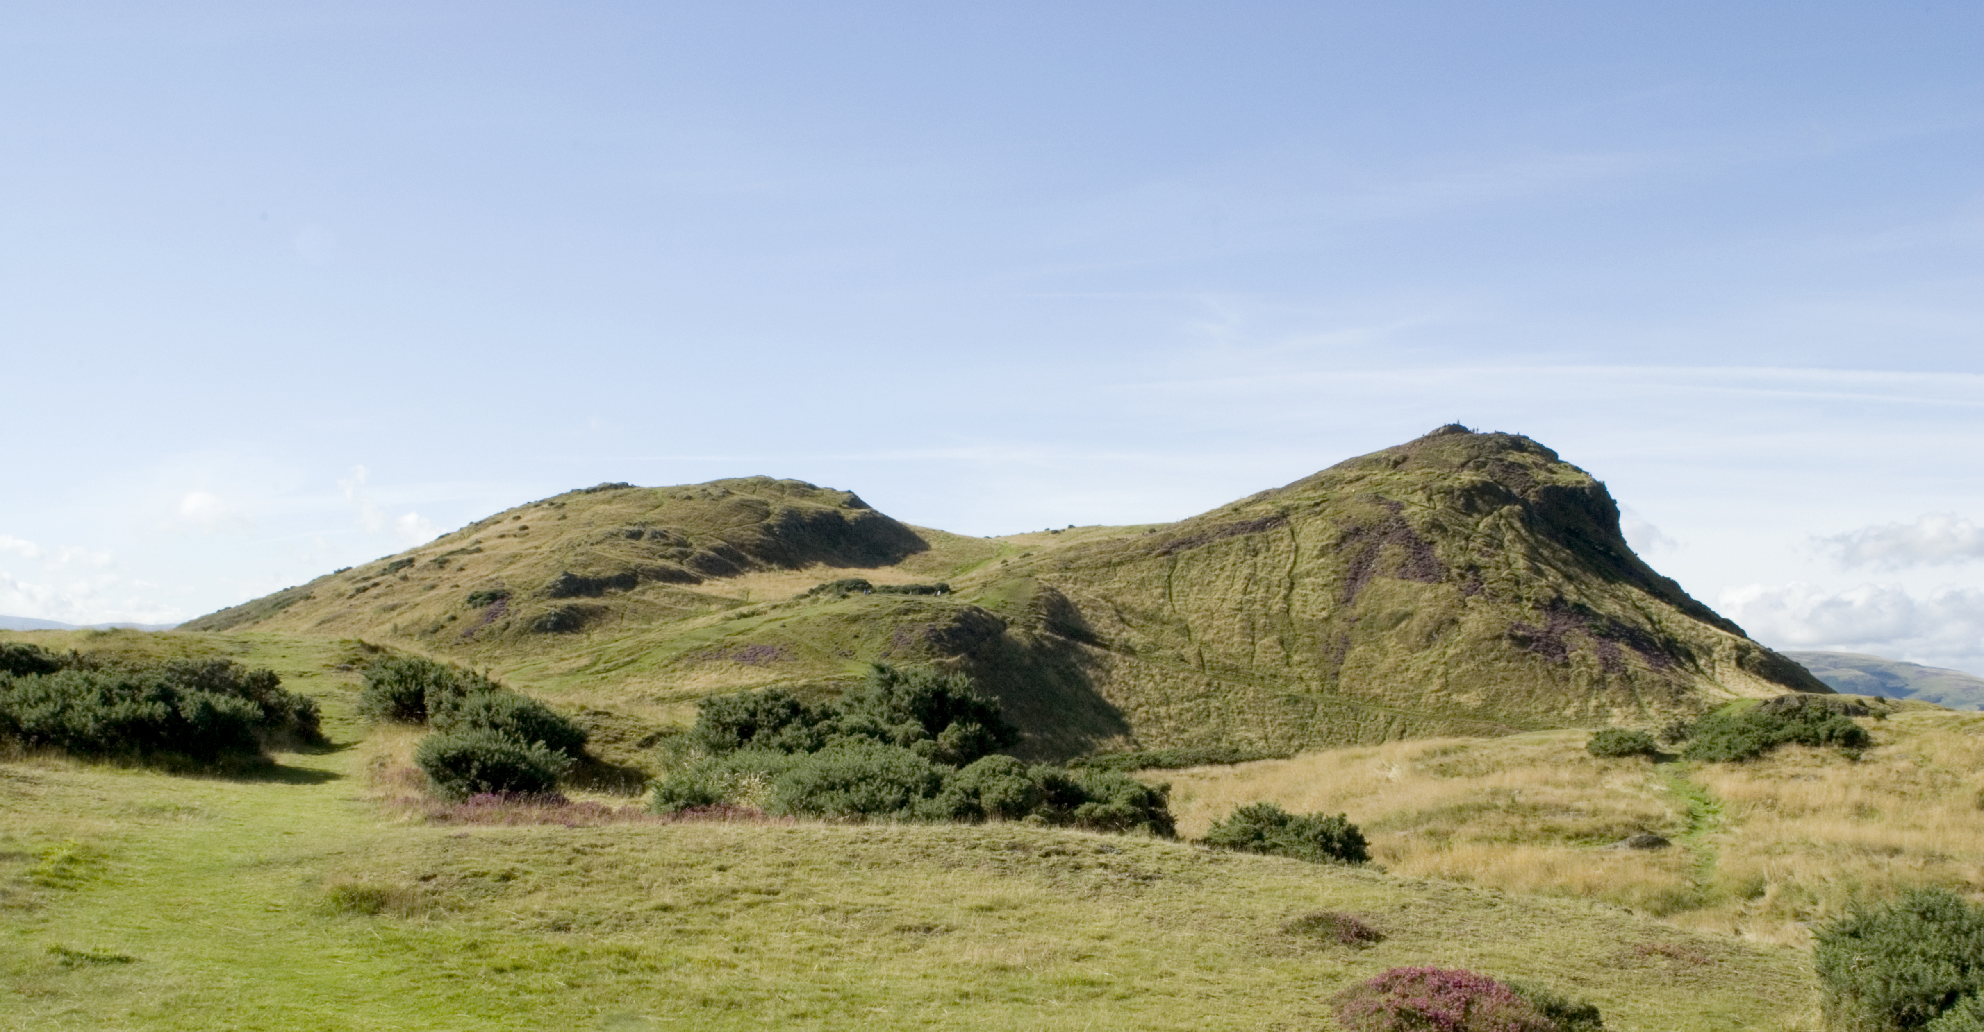
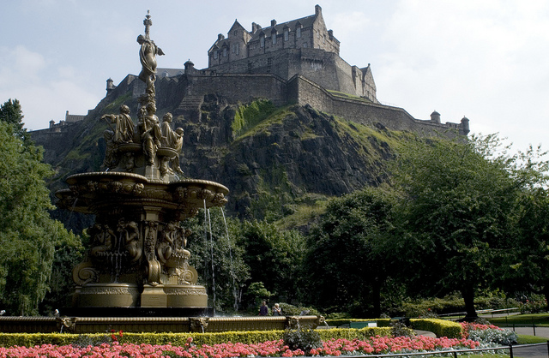

Plenty of Attractions
Edinburgh bursts with historical attractions! From its world-famous castle, perched atop a volcanic rock, to its palace, HM The Queen's official residence in Scotland, and every brick and cobbled alley in between - the city is a historical jewel. And you don't need to travel far from Edinburgh city centre to escape to the beautiful countryside of the Lothians!
Edinburgh Castle

Slide 7
San Antonio, Texas
ISPP’s 2018 Annual Conference Location

Slide 8
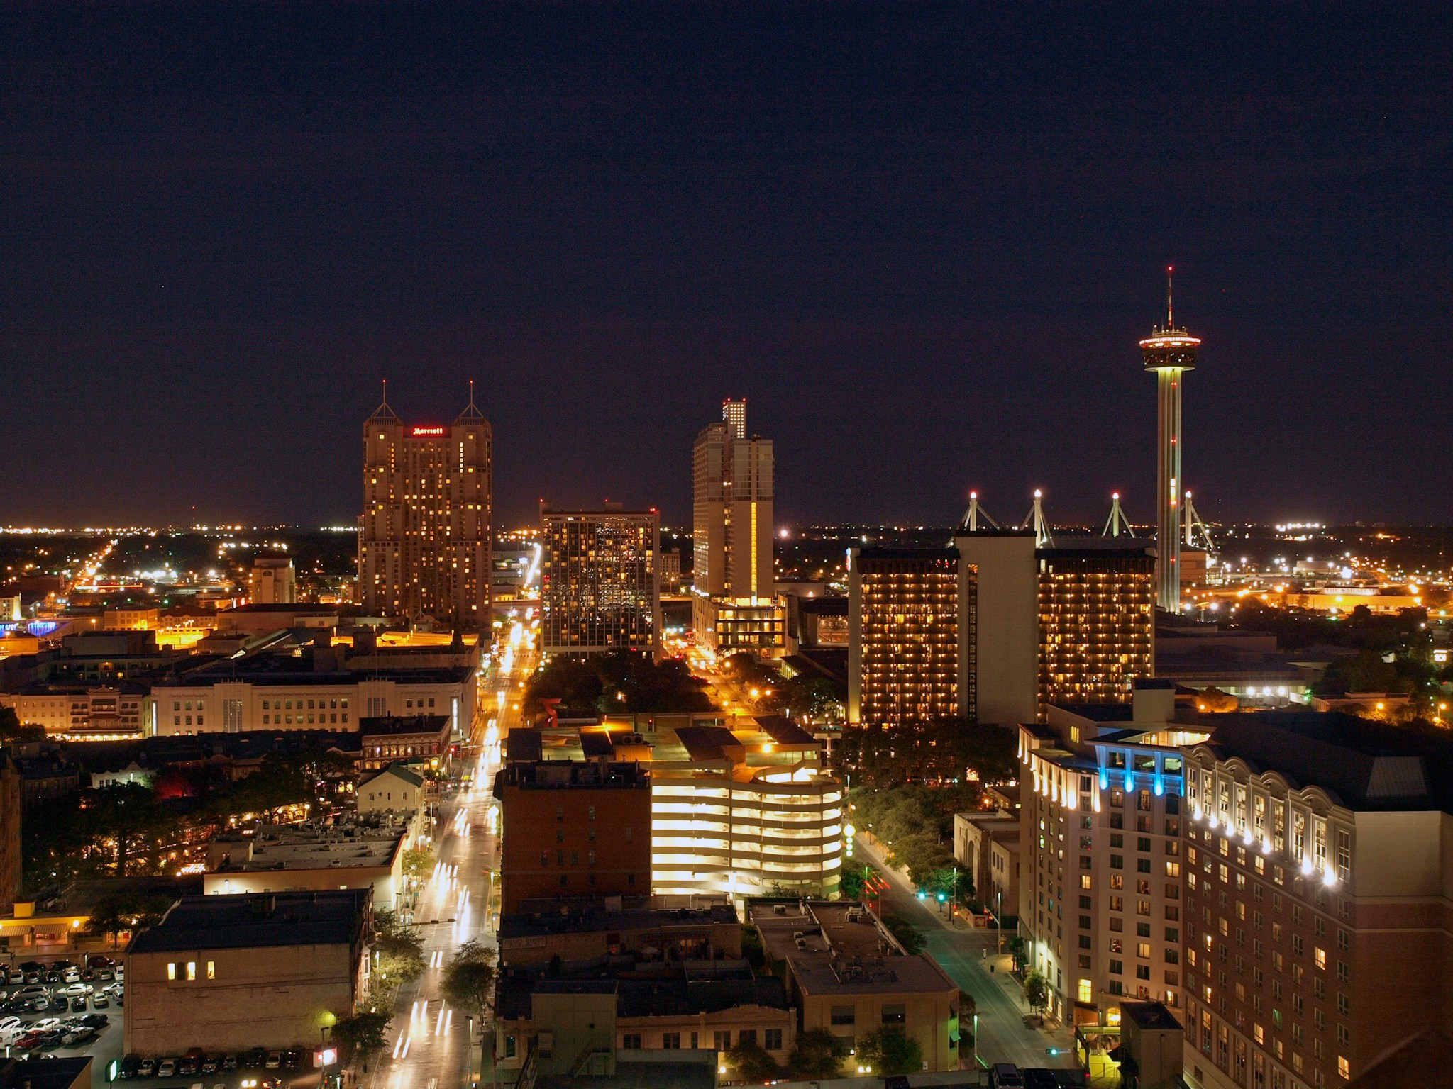
San Antonio
San Antonio’s River Walk, Spanish colonial architecture, and parks and plazas make it one of America’s most picturesque cities. As one of the fastest growing cities in the nation, San Antonio offers modern convenience in the middle of a historic city with diverse artistry, ethnic cuisine and exquisite culture.
Photos credited to visitsanantonio.com

Slide 9
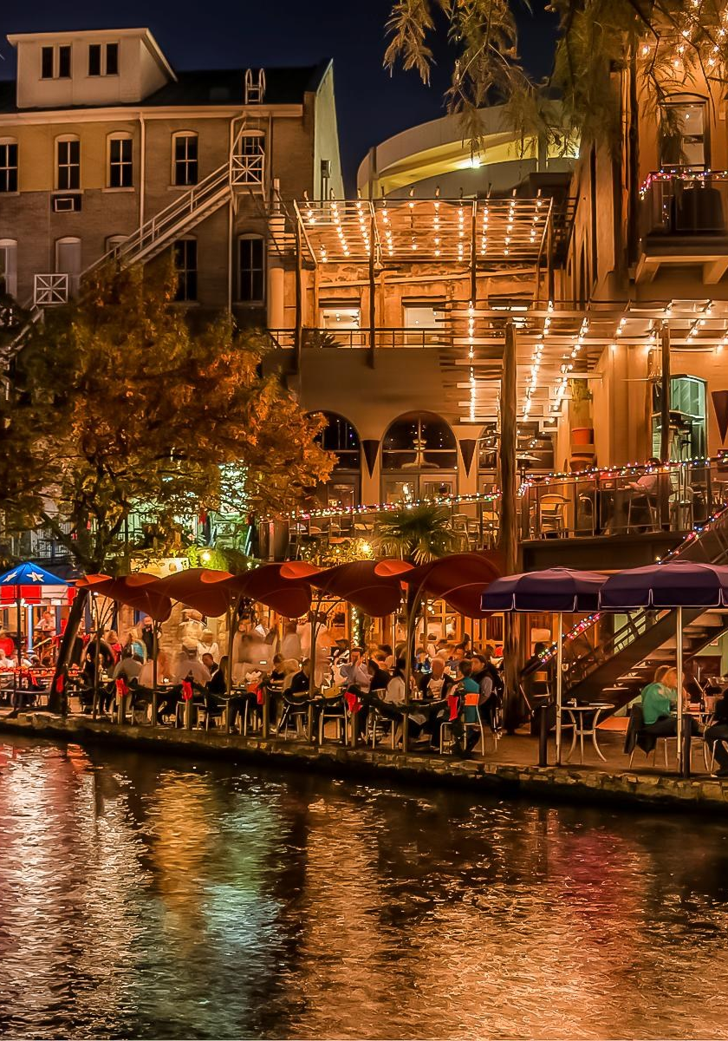
The Riverwalk
The conference hotel is conveniently located along the beautiful San Antonio Riverwalk which offers plenty of restaurants, shops, attractions and more!

Slide 10
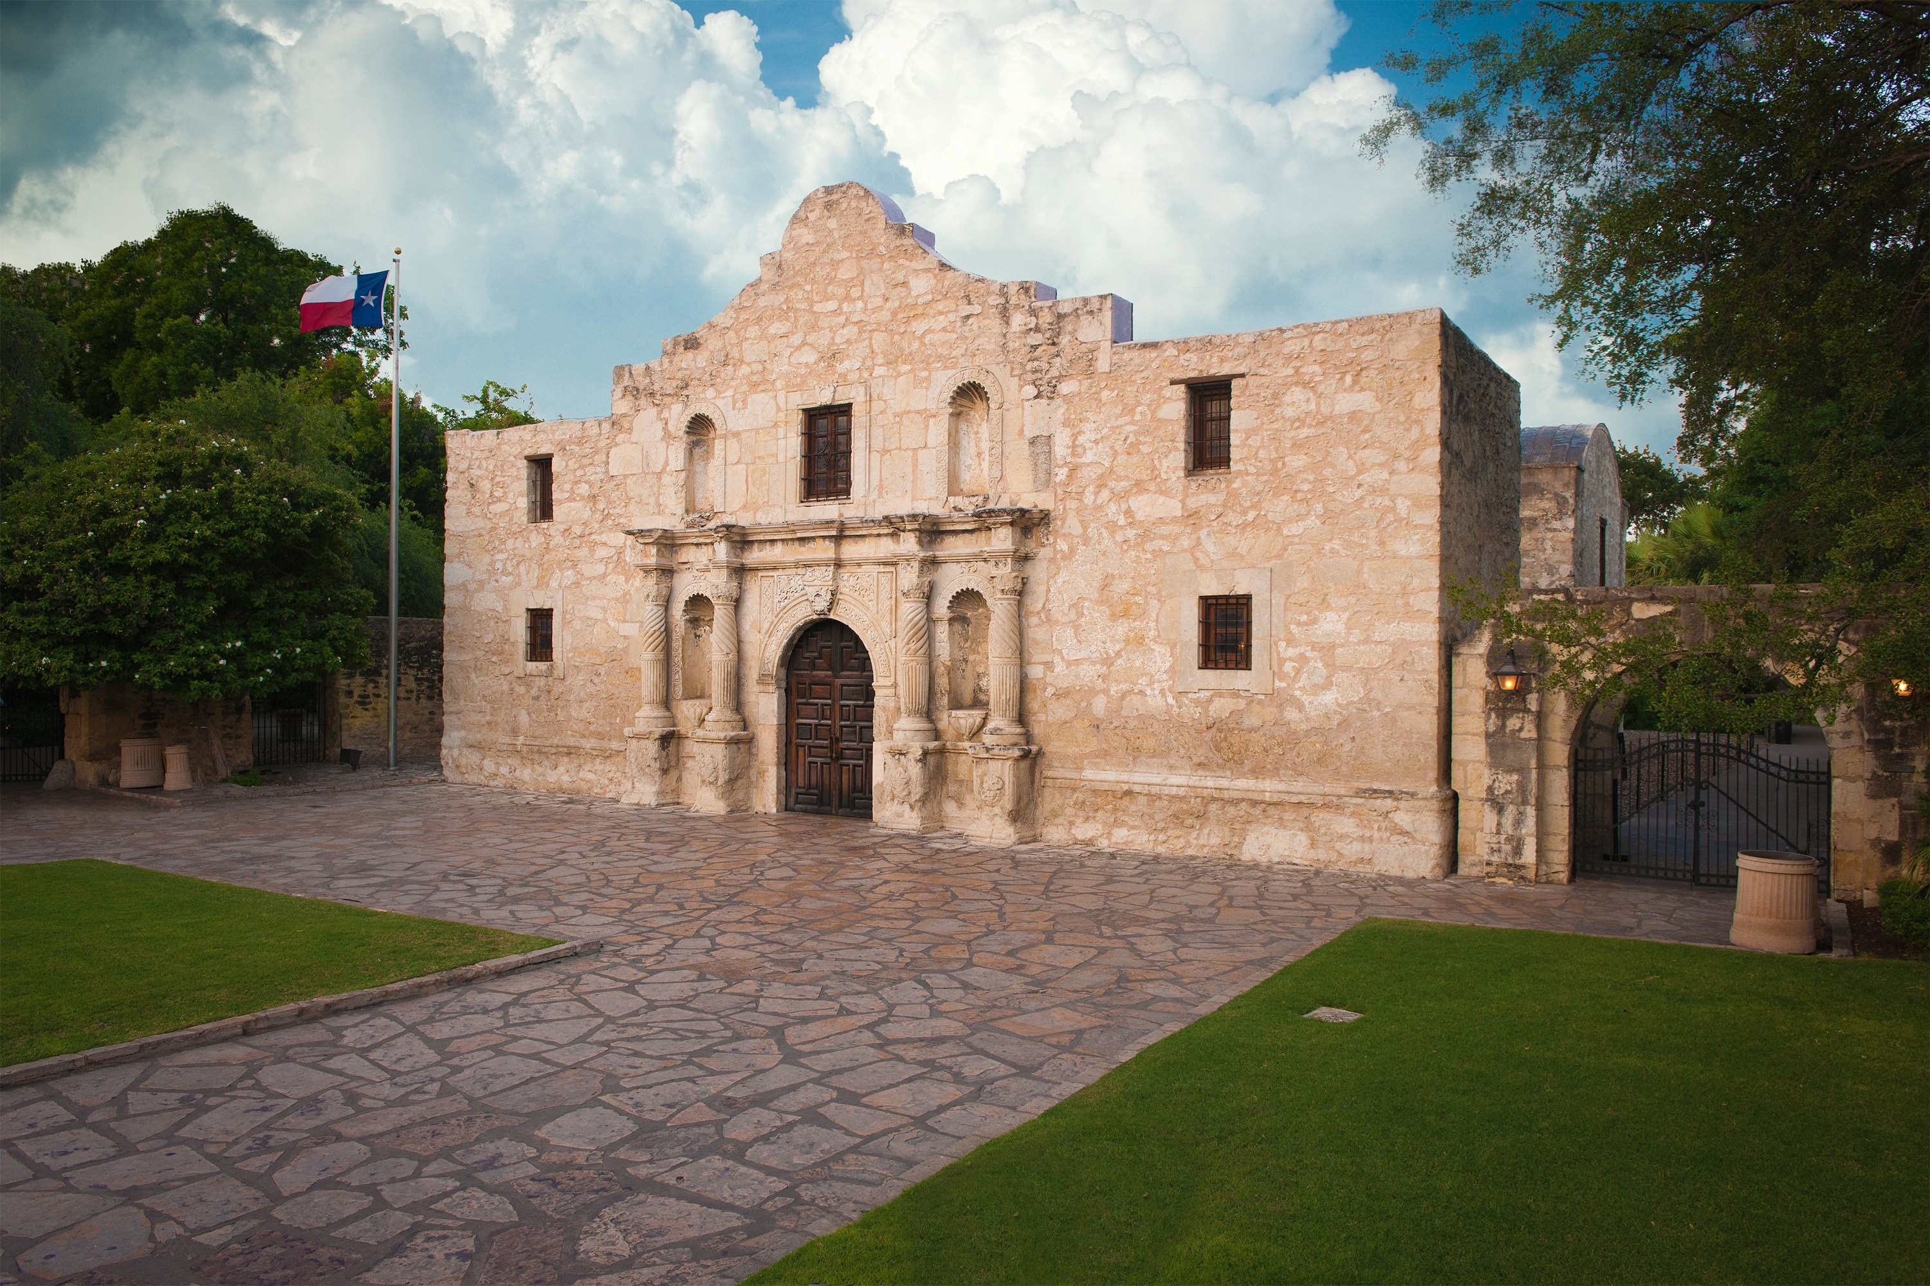
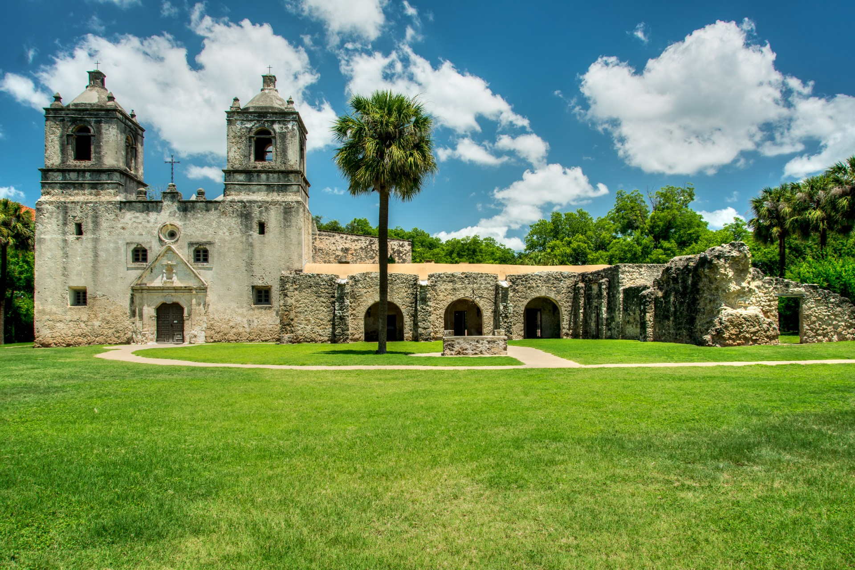
Home to many historical landmarks
The Alamo
Mission Concepcion

Slide 11
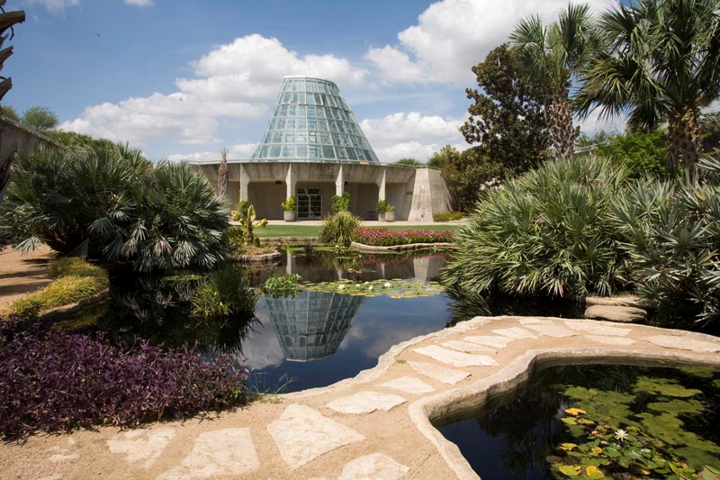
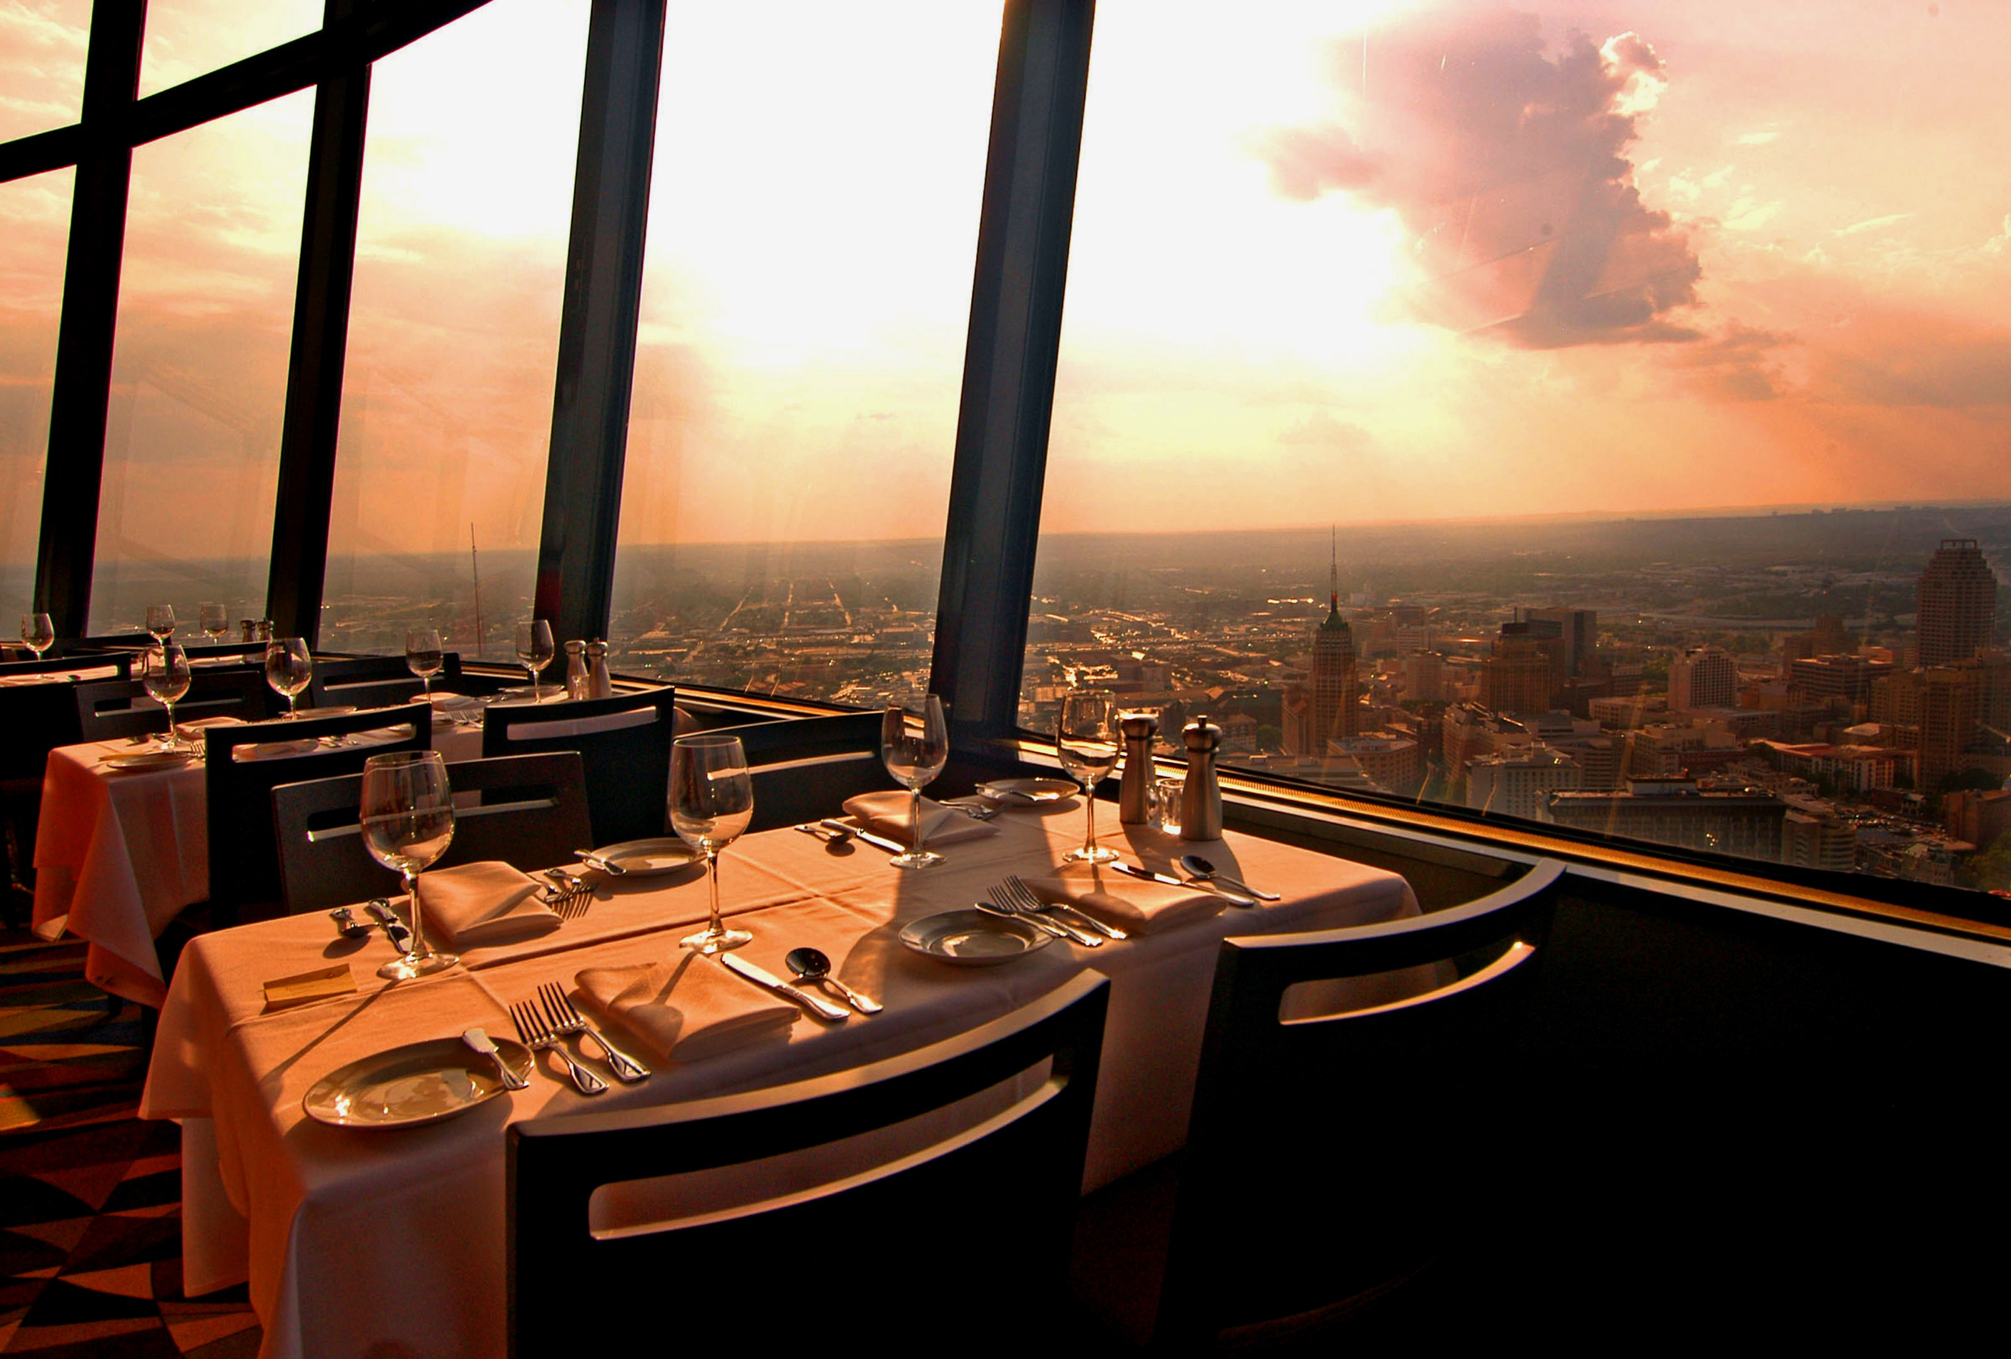
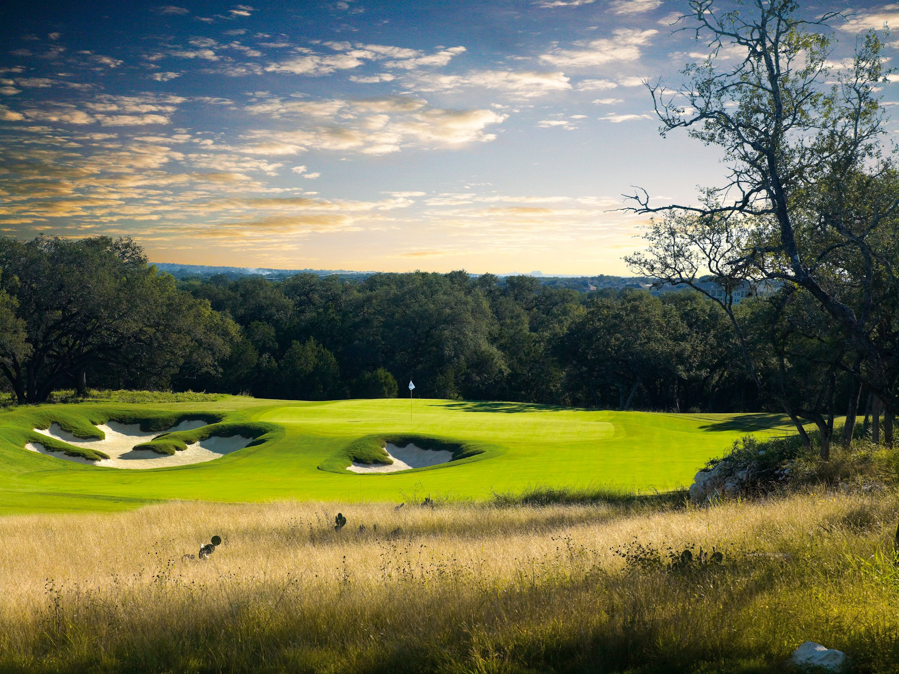
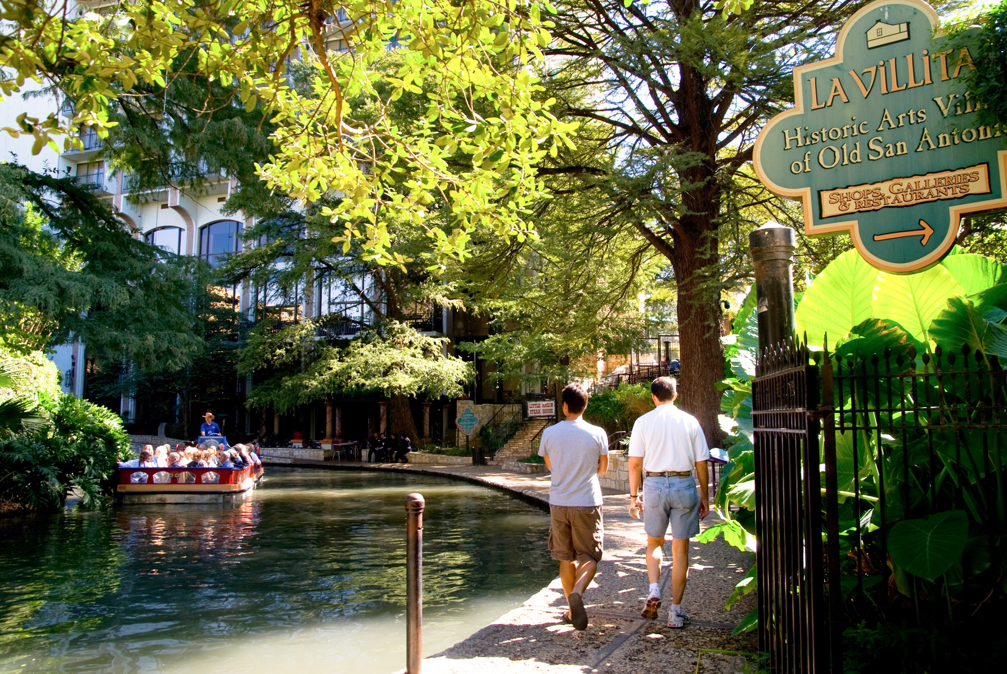
Attractions include but are not limited to…
Botanical
Gardens
Tower of the
Americas
La Villita Historic
Arts Village
TPC Golf
Course

